Slide 1
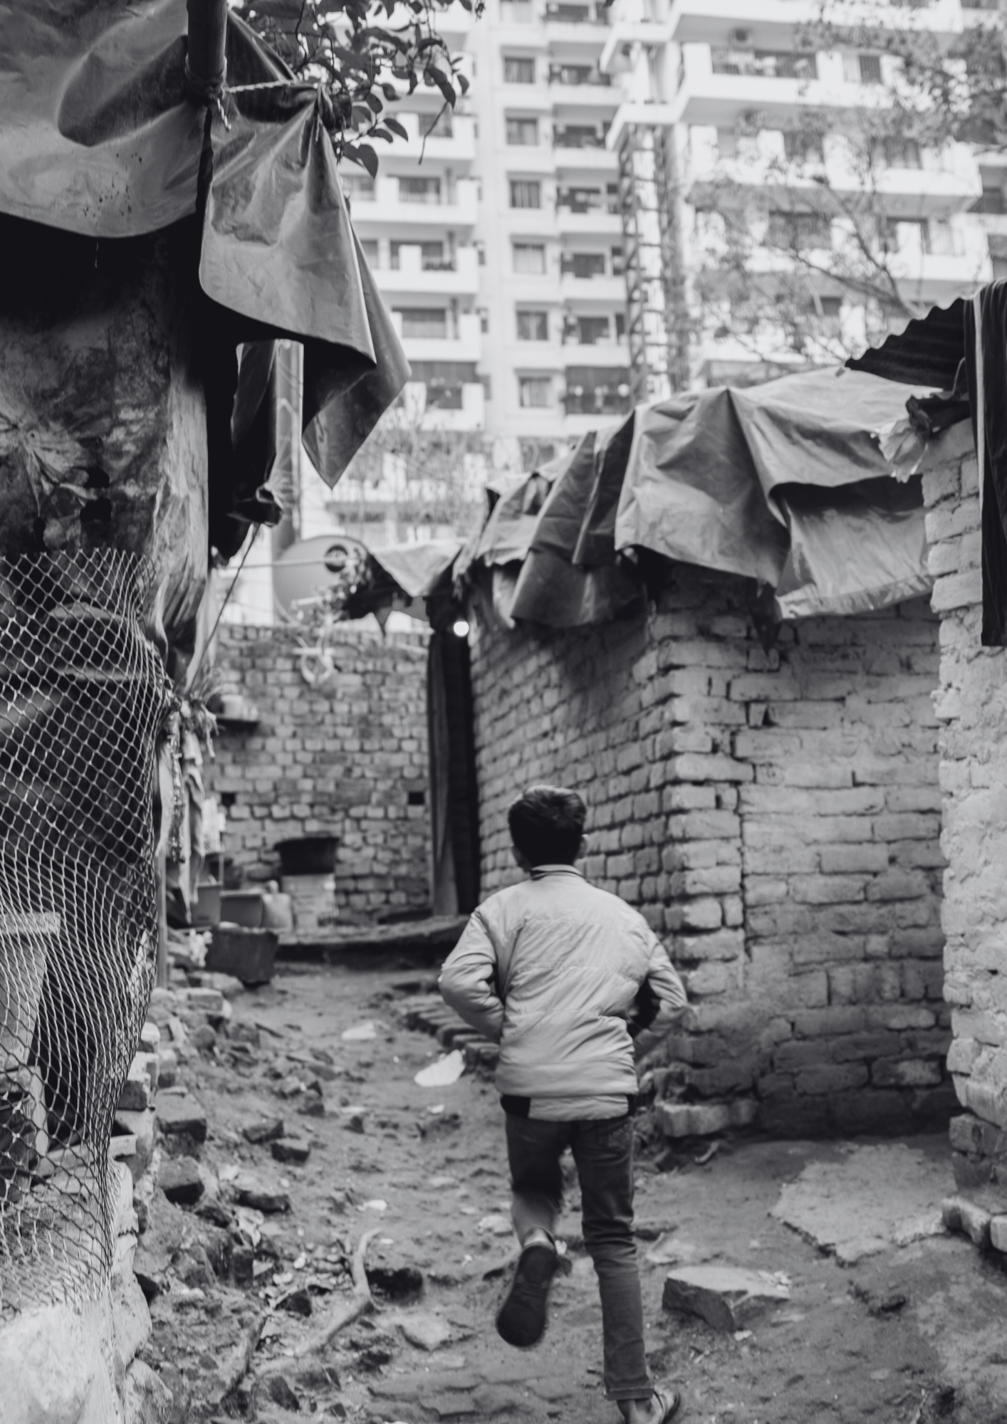


INDIA
Evaluating Provisions of the JJ Act
Which Permit Children Between 16 And 18 To Be Tried As Adults
Deeksha Gujral
Program Director, iProbono India
August 2026

Slide 2
CATEGORIES OF OFFENCES
Offences as per Juvenile Justice (Care and Protection of Children) Act, 2015
Petty
Sentence of up to 3 years
Serious
Fourth category of offences:
Sentence of 3-7 years
Offences that do not fall under any of these three categories
Heinous
Sentence of 7 years or more

Slide 3

The Fourth Category
Shilpa Mittal v. State (NCT of Delhi), (2020) 2 SCC 787
  Offences where the minimum sentence is less than seven years,
  Offences where there is no minimum sentence prescribed but the maximum sentence is more than seven years.
Both these categories were recognised as serious offences.
Statutory acceptance of this framework in the Juvenile Justice (Care and Protection of Children) Amendment Act, 2021.

Slide 4
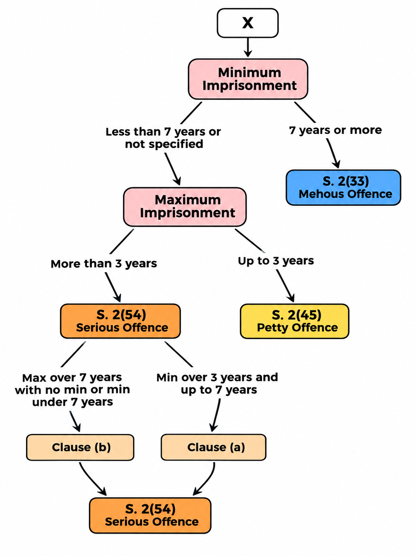
Are there still lacunas?
X vs State of Bihar (Criminal Appeal No. 3299 of 2026, decided on July 21, 2026)

Slide 5

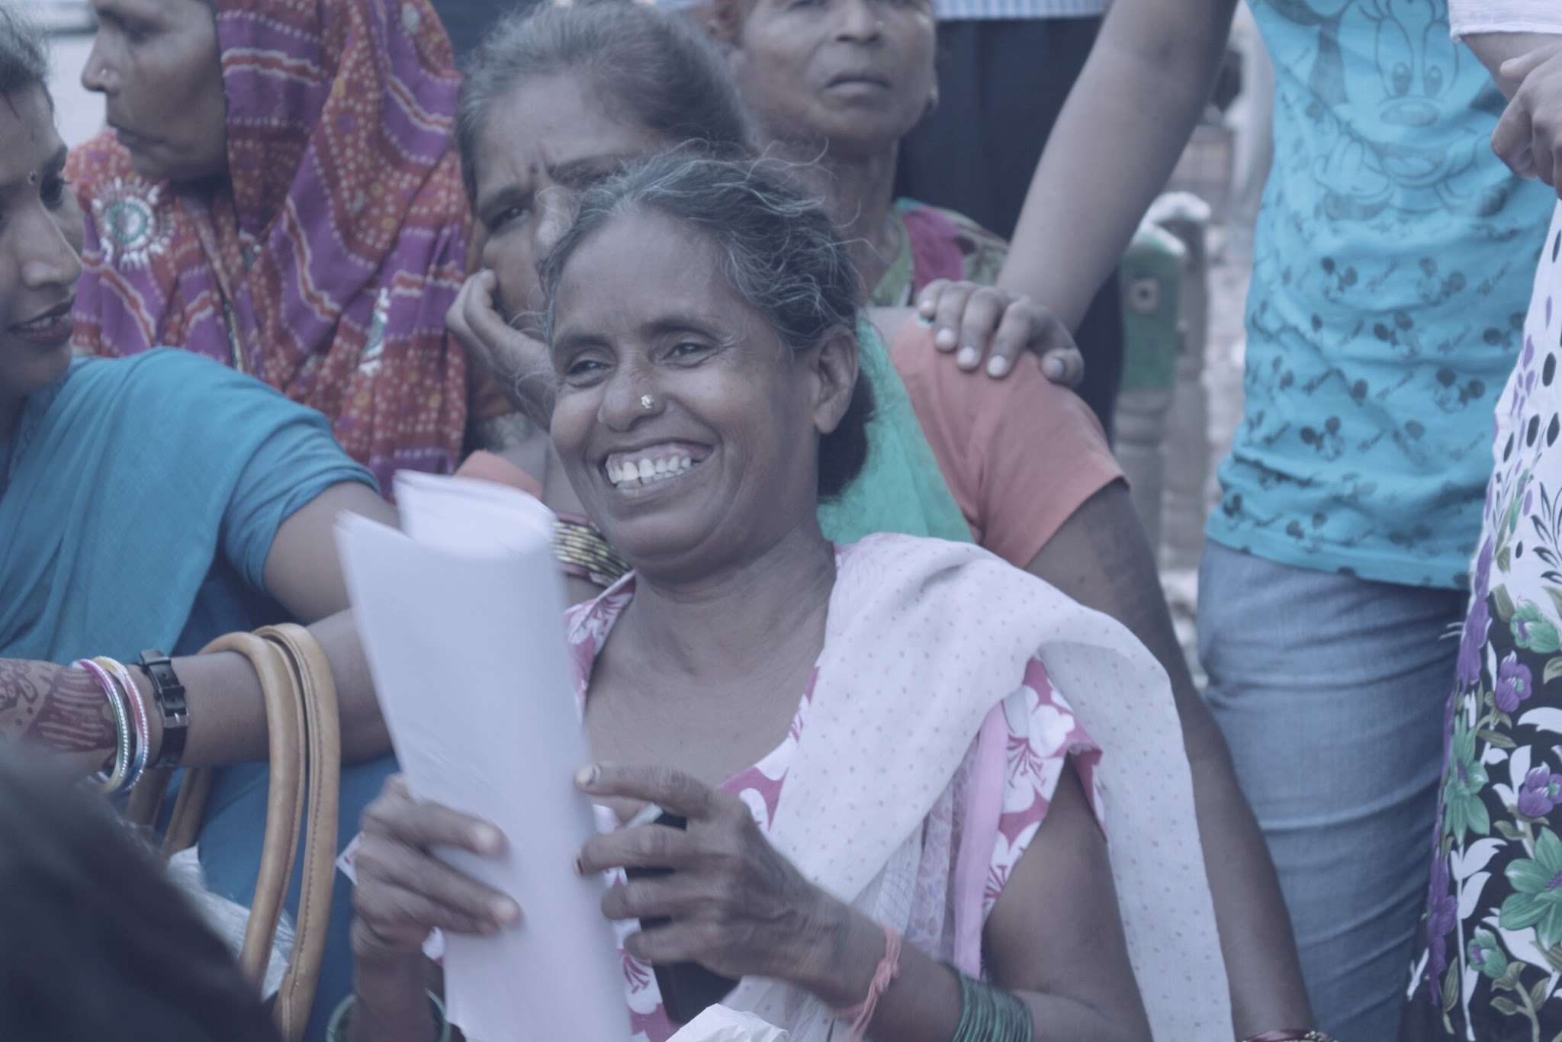
ON-GROUND CHALLENGES
Confusion regarding which category an offence falls under amongst the police and JJBs.
Reliance on the maximum prescribed punishment rather than the minimum punishment when classifying offences.
Lawyers need to push back against CCLs accused of serious offences being transferred to the adult criminal justice system.

Slide 6




PRELIMINARY ASSESSMENT FRAMEWORK
Under Section 15, the JJB must assess four factors
Physical capacity
Mental capacity
Circumstances in which the alleged offence was committed
Ability to understand the consequences of the alleged offence
The four factors are cumulative, not alternatives or intended to give a broad indication of the child’s maturity.

Slide 7
WHAT IS MENTAL CAPACITY?
Mental capacity concerns the child's ability to make decisions and exercise judgment within the social context of the alleged offence. It is not the mere absence of a mental illness.
Assessments should consider:
Cognitive functioning
Substance Use
1
6
Emotional Regulation
Trauma and Abuse
2
7
Decision Making
Neglect and inadequate supervision
3
8
Impulse Control
Peer Influence
4
9
Psychosocial Development
Environmental Factors
5
10

Slide 8
WHAT DOES IT MEAN TO UNDERSTAND THE CONSEQUENCES?
Legal consequences
Social Consequences
How the act affects relationships, reputation and social life
What the law may do
Interpersonal consequences
Long-term consequences
Impact on victim, family and relationships
Impact on the child's own future and psychological well-being

Slide 9
WHICH CIRCUMSTANCES ARE TO BE LOOKED AT?
The assessment should consider:
Peer influence
1
Trauma and abuse
7
Coercion or threats
2
Substance use
8
Poverty and financial stress
3
Emotional stress
9
Family environment
4
Social environment
10
Parental supervision
5
Situational triggers
11
Education
6

Slide 10
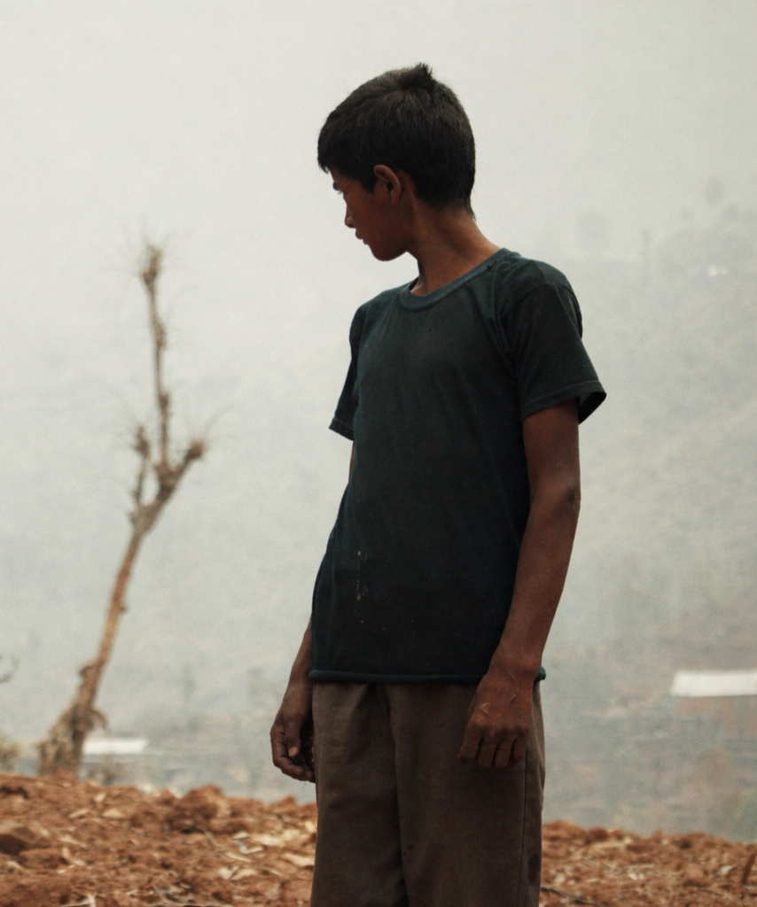
GROUND REALITIES AND LIMITATIONS
CCLs are often misled about the purpose of the PA, and are told they are going for counselling. CCLs end up incriminating themselves.
PAs may contain the child's statement/confessional narrative in detail, and the child's own words can become material used against them at trial.
PA reports frequently focus on the alleged offence rather than looking at the child's life. Limited exploration of emotional state, peer influence, family circumstances, trauma, substance use, and developmental vulnerabilities.

Slide 11

GROUND REALITIES AND LIMITATIONS
Absence of a diagnosed mental/intellectual disability is perceived as the child having mental capacity.
Consequences are often reduced to the immediate consequences of the act.
In several cases, substance use or dependency is noted but not meaningfully connected to decision-making, impulse control or capacity.
PA reports often carry a specific section about previous antecedents.

Slide 12
FUNDAMENTAL SAFEGUARDS FOR PRELIMINARY ASSESSMENTS AS PER LAW
PA must remain anchored in the presumption of innocence
PA must remain anchored in the child’s participation
PA is NOT a trial
The assessment cannot proceed on assumed guilt or rely on self-incriminatory disclosures.
The child and guardian must be able to meaningfully participate and understand the process.
The purpose is to assess capacity, not culpability.
These safeguards are essential to prevent the PA from becoming a preliminary criminal trial.

Slide 13
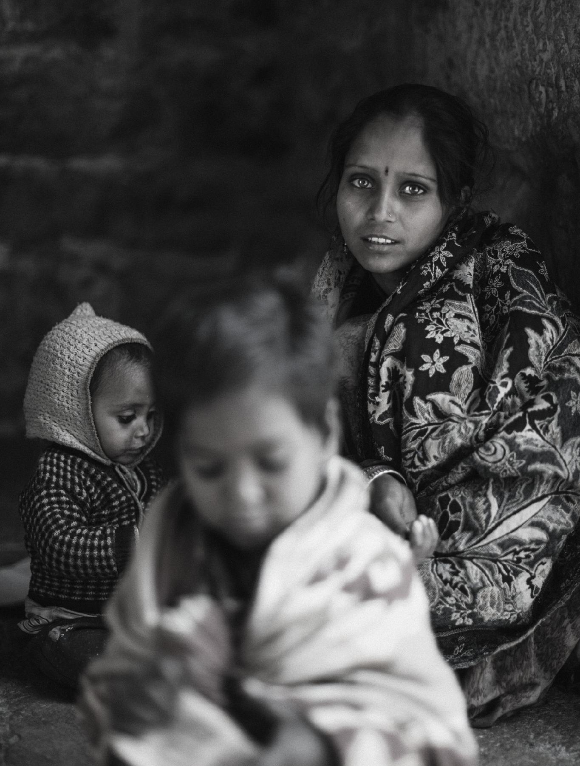

Reach out to us: communications@i-probono.com

